Slide 1

Section 5.3 The Fundamental Theorem of Calculus
Lecture 1
Connecting change and area

Slide 2

Homework Submission to Canvas
Preview of section
Skim the section in text and write a short paragraph summary.
Give a bulleted list of all important definitions, theorems, and formulas without details.
Notes on video lectures
Take notes on everything written on slides including all details, worked examples, on-own activities, as well as your own thoughts and questions.
Try on-own activities first, then write down provided solution next to it for comparison.
Worked examples from the text
Write down the problem and attempt without looking at the solution.
Use the solution to write the best explanation you can.
Solutions to textbook exercises
Model approaches and explanations given in the video lectures and textbook examples.
Final reflection of section
List the key takeaways to remember as a bulleted list.
Video reflection (for some sections)
Write a 1 paragraph reflection on the video discussing what you found most interesting or useful.

Slide 3
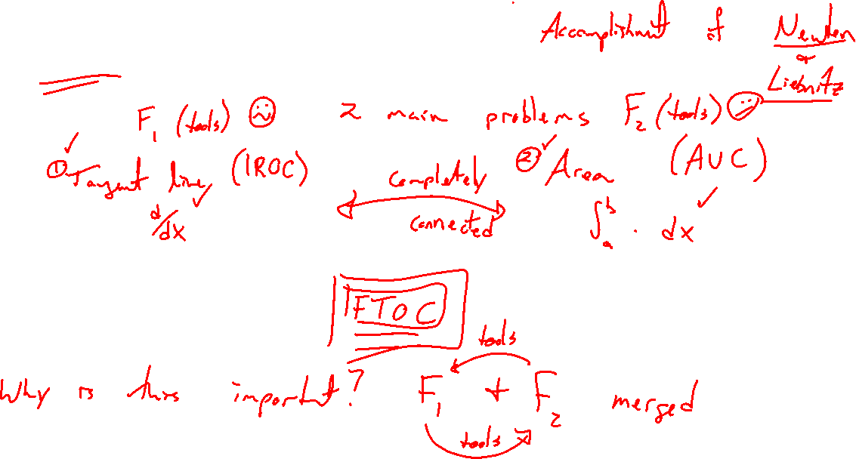
Biggest idea of this course....
Notes:
Tangent line and area problems are completely connected (reverses of eachother).
Results from each flow into eachother. Area becomes much easier.
This is Newton and Liebnitzs primary conrivution

Slide 4
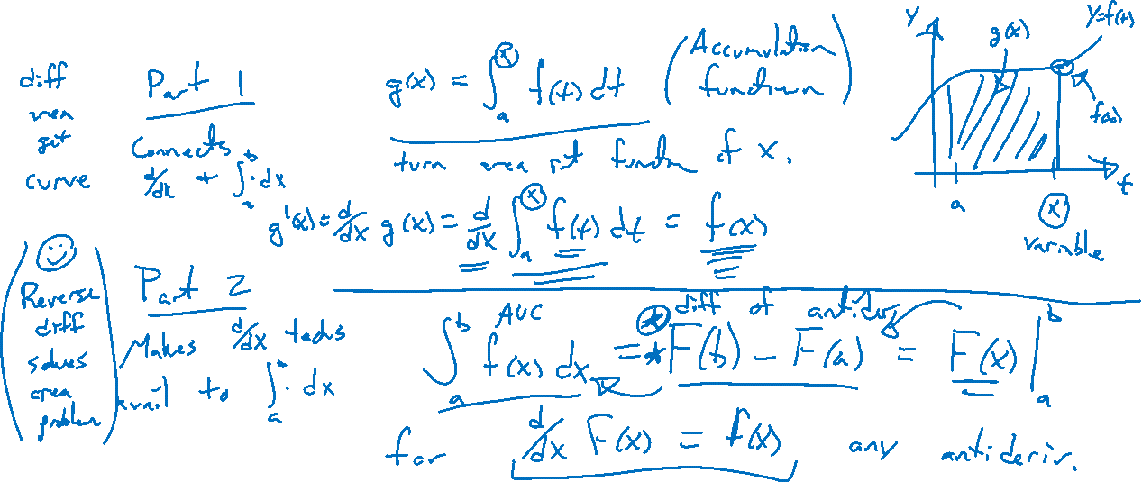
Theorem: Fundamental Theorem of Calculus
Notes:
Part 1: For g(x) = \int_a^x f(t)~dt, g'(x) = f(x) (key connection)
Part 2: \int_a^b f(x) ~dx = F(b)-F(a) (most useful.

Slide 5
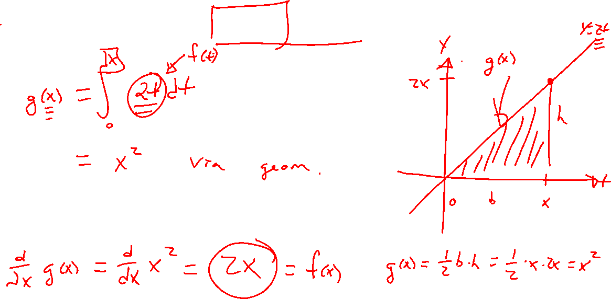
Example: Idea of FTOC Part 1
Notes:
Accumulation function: g(x) = \int_0^x 2t ~dt (turn area into function)
Compute g'(x). (differentiate area to get curve)
Main point is area and derivative are connected.

Slide 6
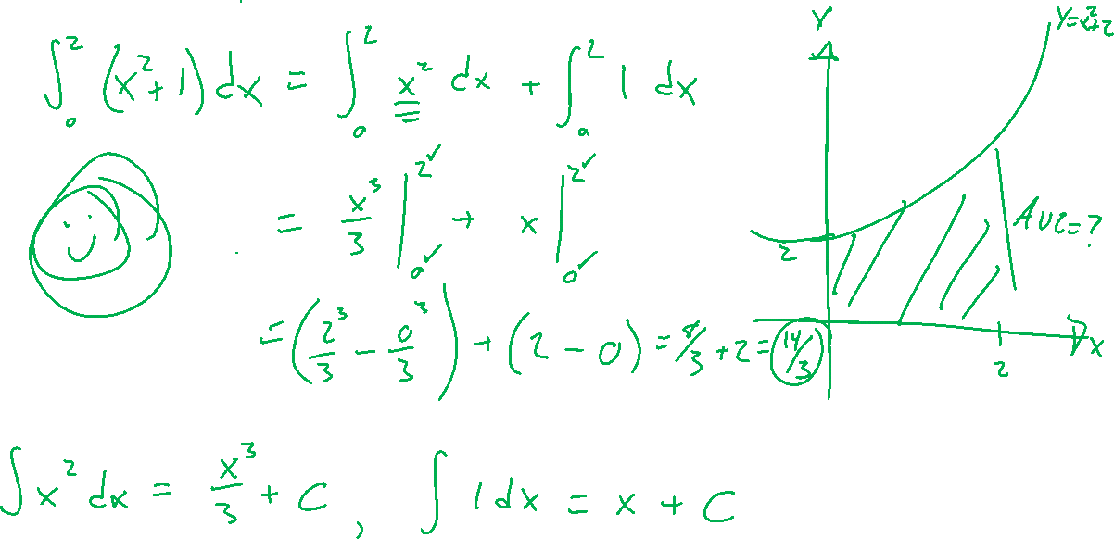
Example: Idea of FTOC Part 2
Notes:
\int_0^2(x^2+1) ~dx
No more Riemann sum

Slide 7
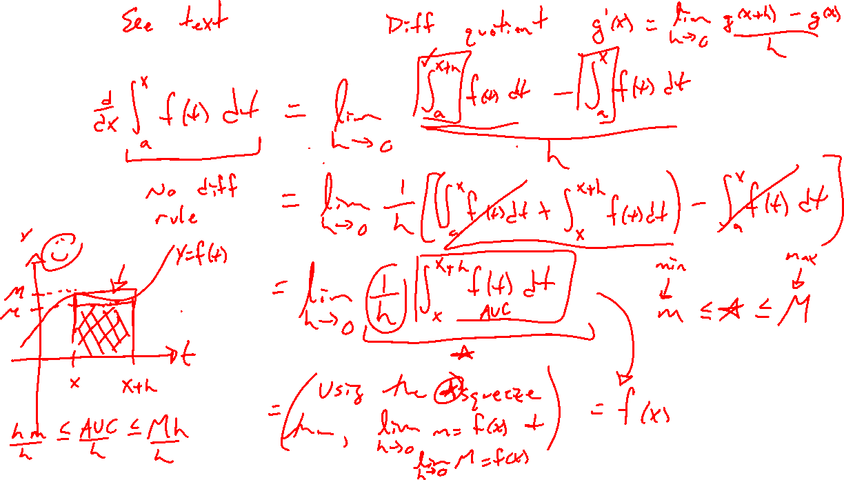
Proof: FTOC Part 1
Notes:
Difference quotient plus squeeze theorem: m \leq f(x) \leq M

Slide 8
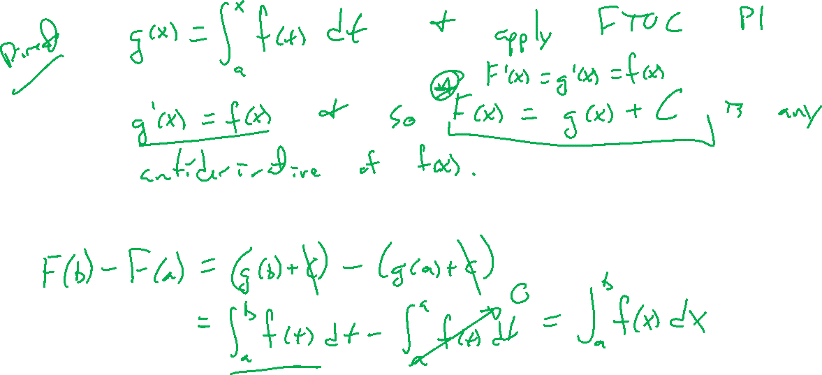
Proof: FTOC Part 2
Notes:
Evaluate accumulation function at x=b knowing that g'(x) = f(x)

Slide 9
Example: Try on own
Notes:
\int_{-1}^3 (x-1)(2x+1) dx

Slide 10

Textbook Examples and Exercises
Rework examples 1, 4, 5, 6 in the text. Steps:
Write down a problem.
Close the book and attempt on own.
Check / correct your solution against the text solution.
If needed, rewrite the problem to be of the quality of the text solution.
Complete exercises 3, 9, 13, 27, 35
Write solutions of the same quality as in lecture and text solutions.
Check your solution against the answer in the back of the book.
Video reflection
https://www.youtube.com/watch?v=rfG8ce4nNh0&list=PLZHQObOWTQDMsr9K-rj53DwVRMYO3t5Yr&index=8

Slide 11
Homework Submission to Canvas
Preview of section
Skim the section in text and write a short paragraph summary.
Give a bulleted list of all important definitions, theorems, and formulas without details.
Notes on video lectures
Take notes on everything written on slides including all details, worked examples, on-own activities, as well as your own thoughts and questions.
Try on-own activities first, then write down provided solution next to it for comparison.
Worked examples from the text
Write down the problem and attempt without looking at the solution.
Use the solution to write the best explanation you can.
Solutions to textbook exercises
Model approaches and explanations given in the video lectures and textbook examples.
Final reflection of section
List the key takeaways to remember as a bulleted list.
Video reflection (for some sections)
Write a 1 paragraph reflection on the video discussing what you found most interesting or useful.

